Slide 1
The Children’s University’s fifth annual Conference
Monday 10th and Tuesday 11th December 2012
Shrigley Hall Hotel, Golf and Country Club

Slide 3
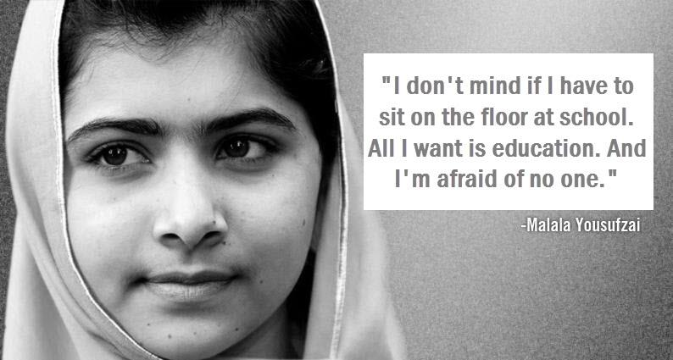

Slide 4
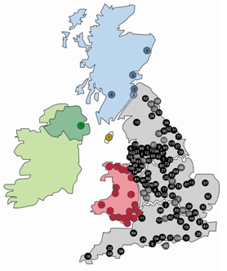
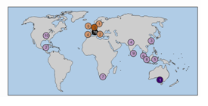

Slide 6
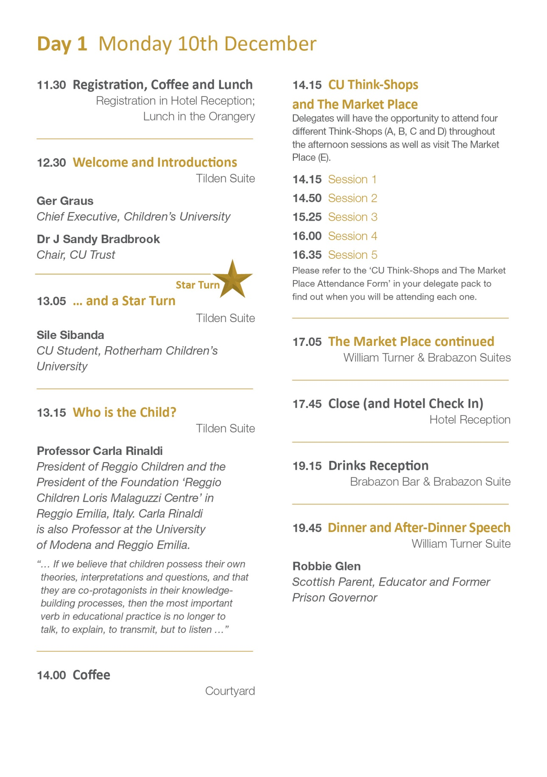

Slide 7
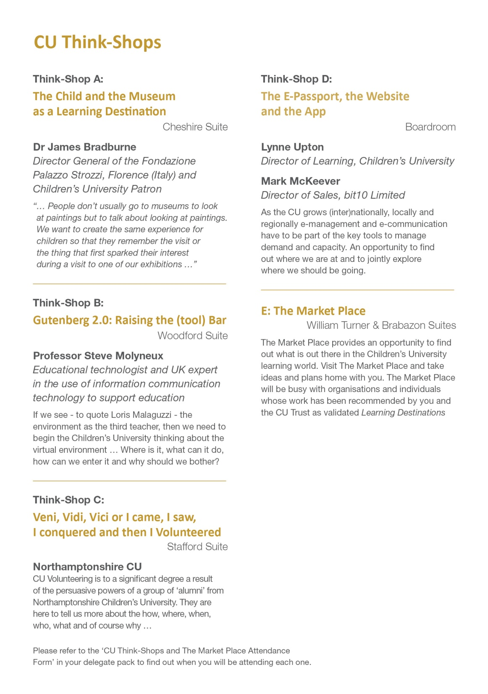

Slide 8
