Slide 1
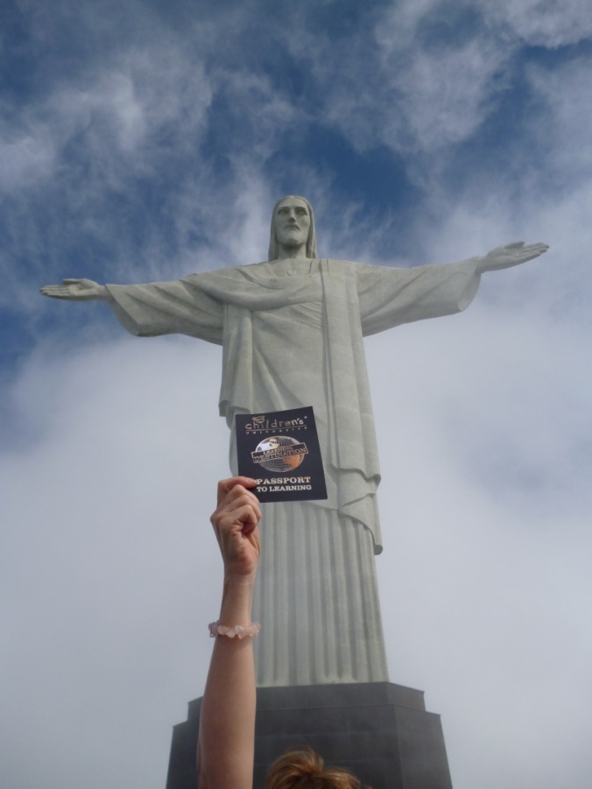
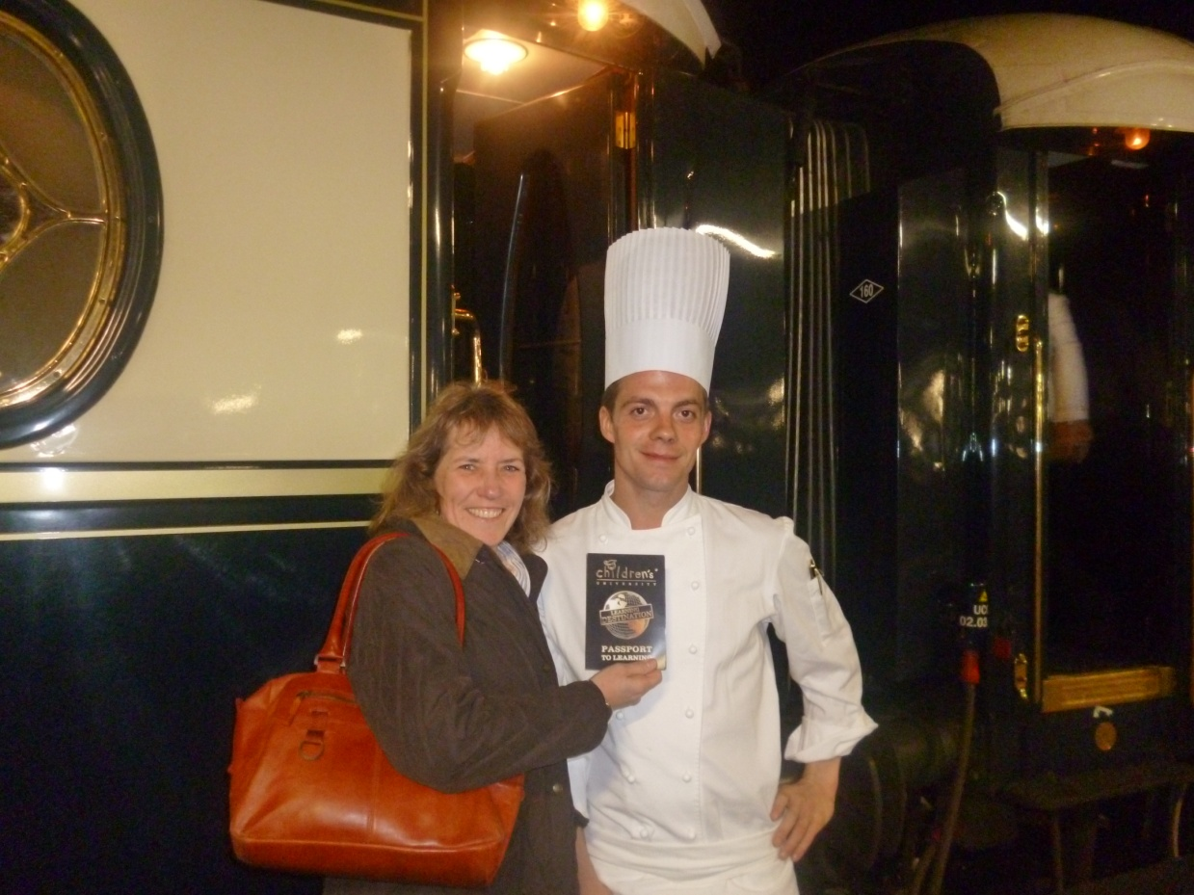
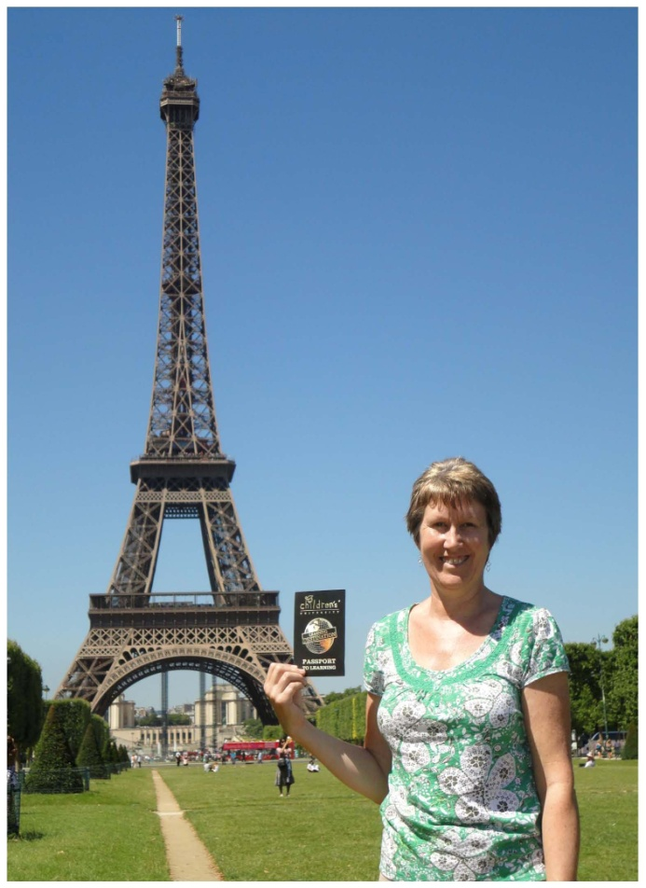
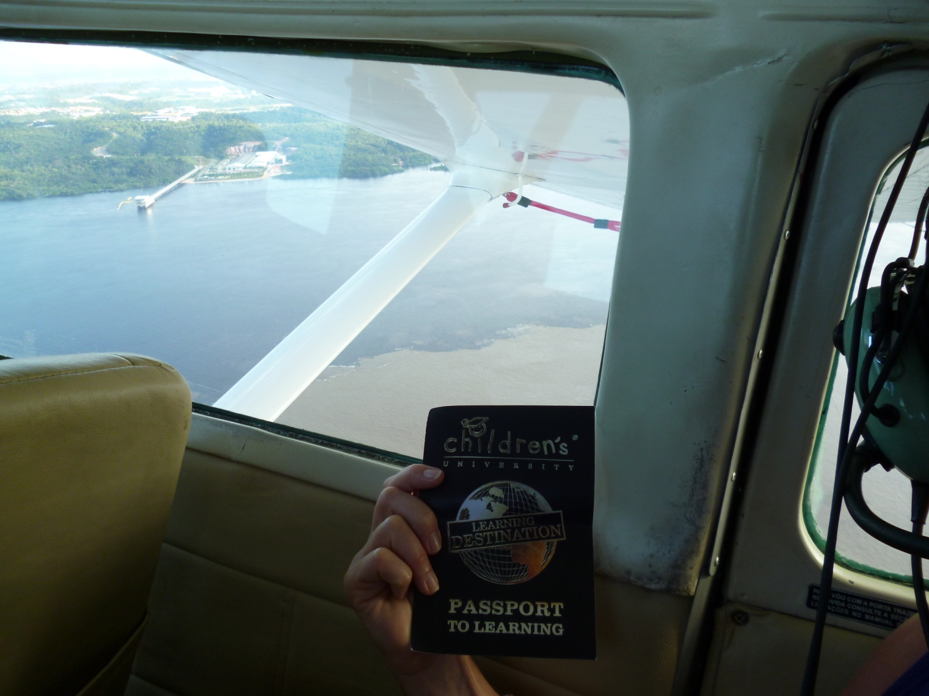
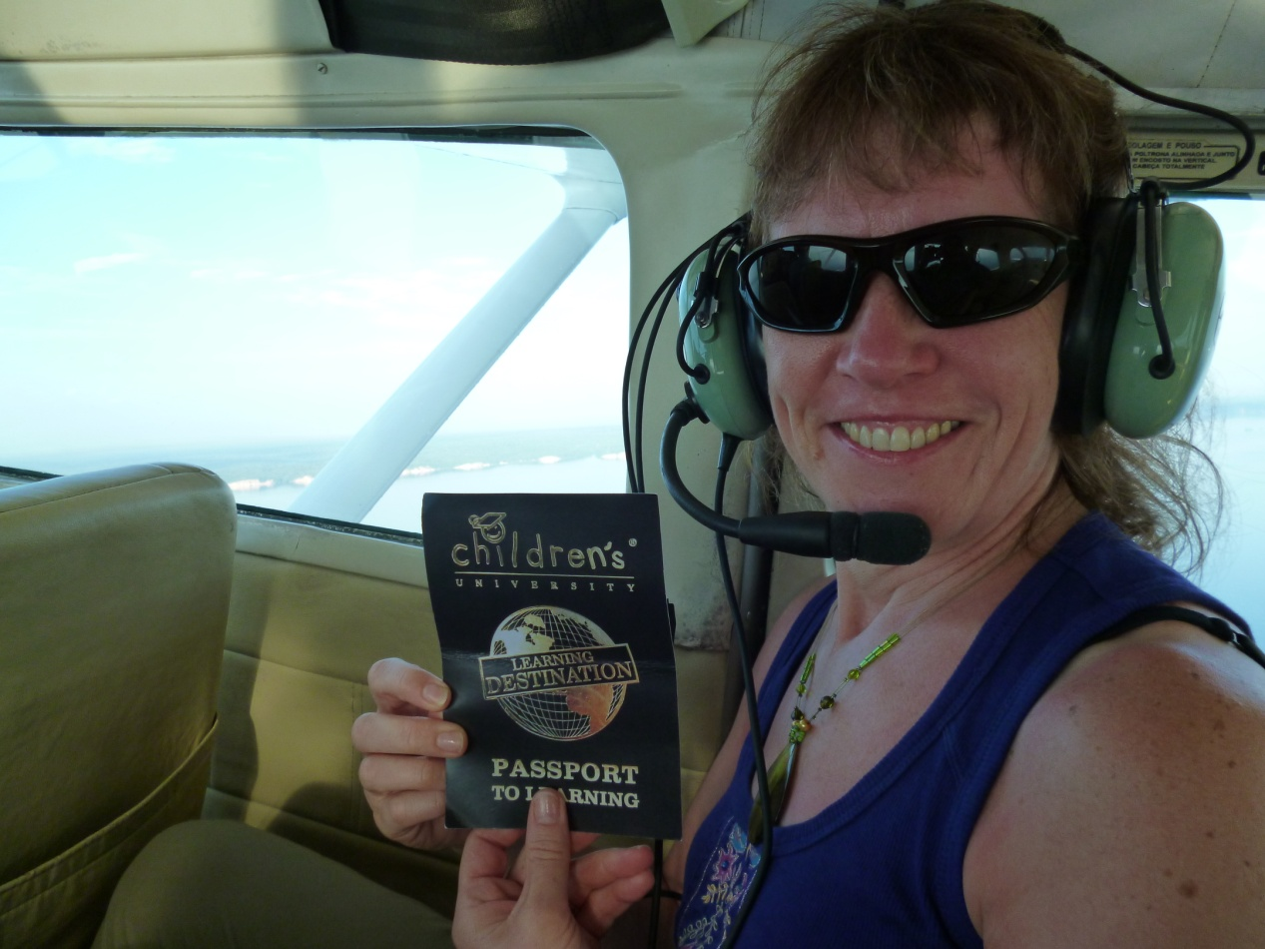
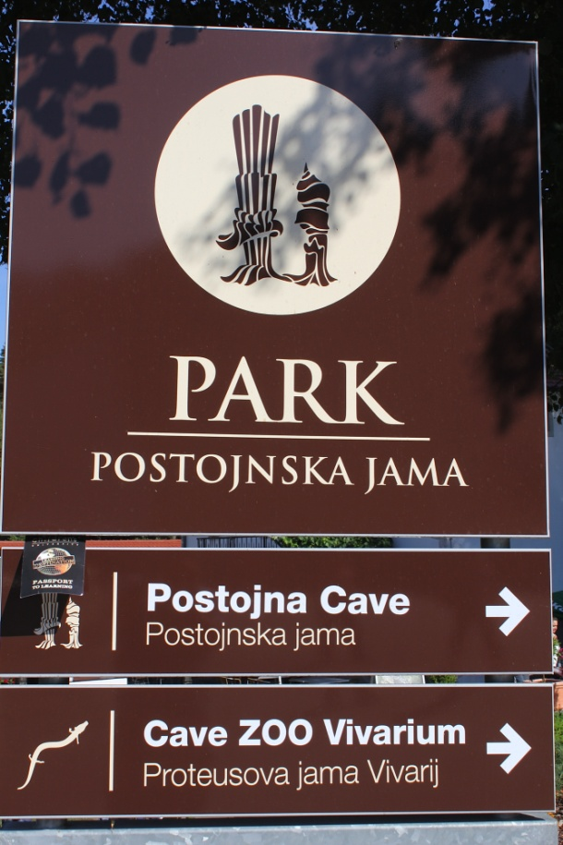
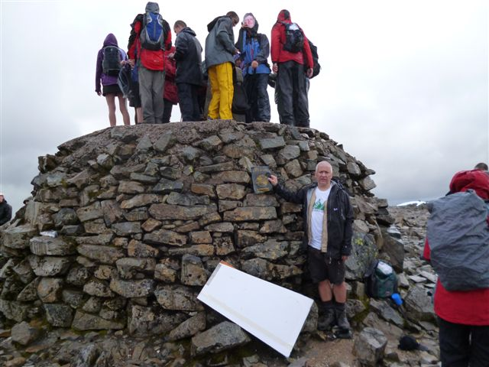

Slide 2
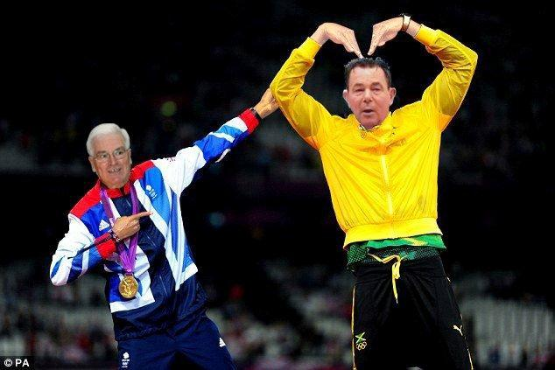

Slide 3
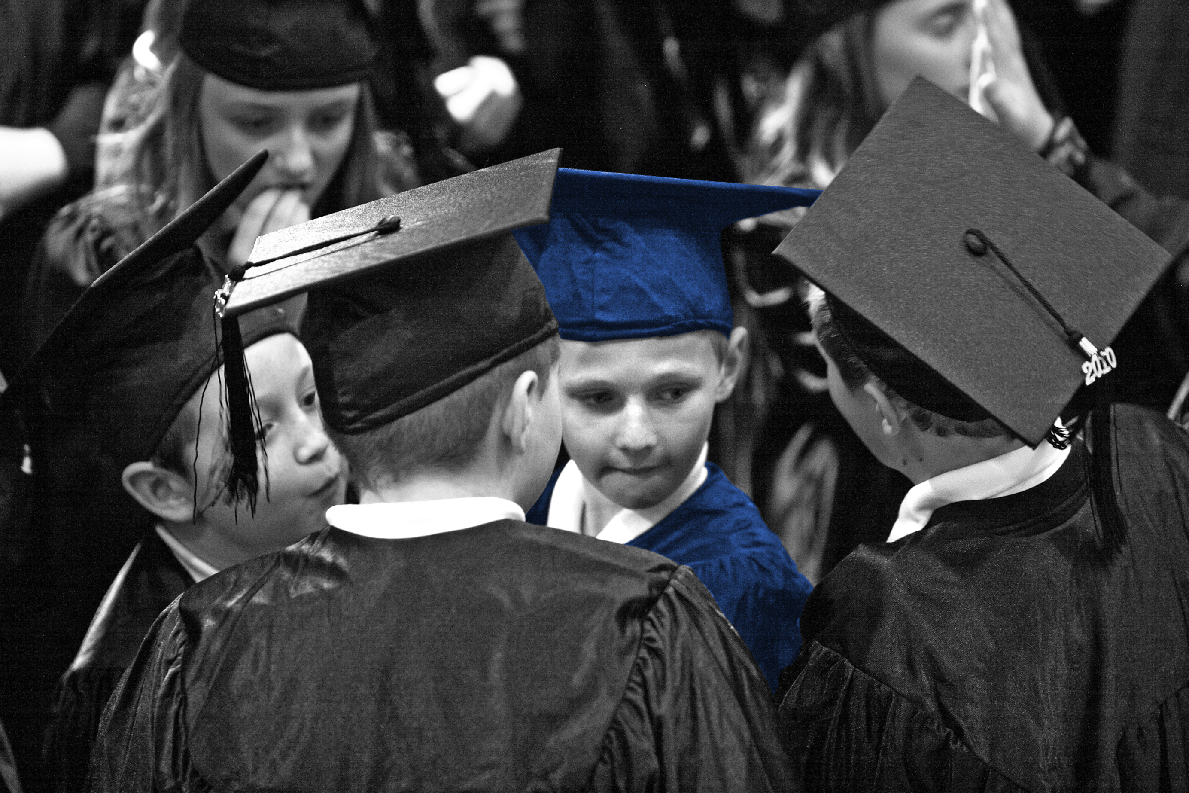
In 2012 there were 105,000 7 to 14 year olds
and 11,000 5 and 6 year old children in England
for 2,740,000+
Children’s University learning hours …
across the British Isles in 2012 136,000 children participated in
3,000,000+ hours of Children’s University learning

Slide 4
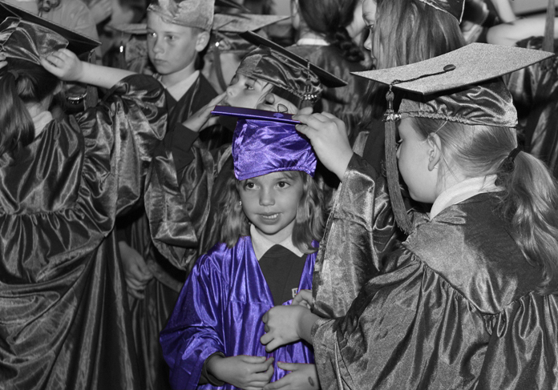
Since 2009 250,000 Passports To Learning
have been in use
in England
in 2,200+
public Learning Destinations …
and
in 3,000 schools and academies

Slide 5
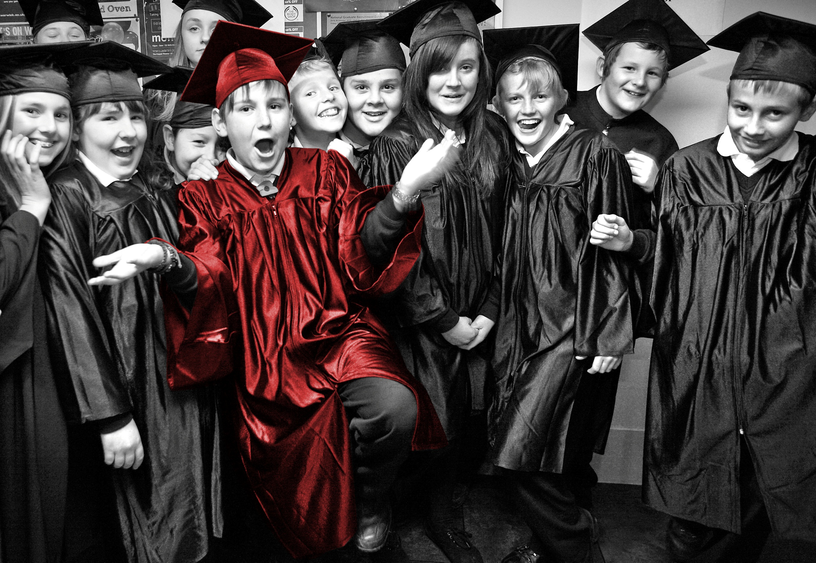
at 90
local Children’s Universities
in England
from January 2013 …
… and a further 20 expressions of interest

Slide 6
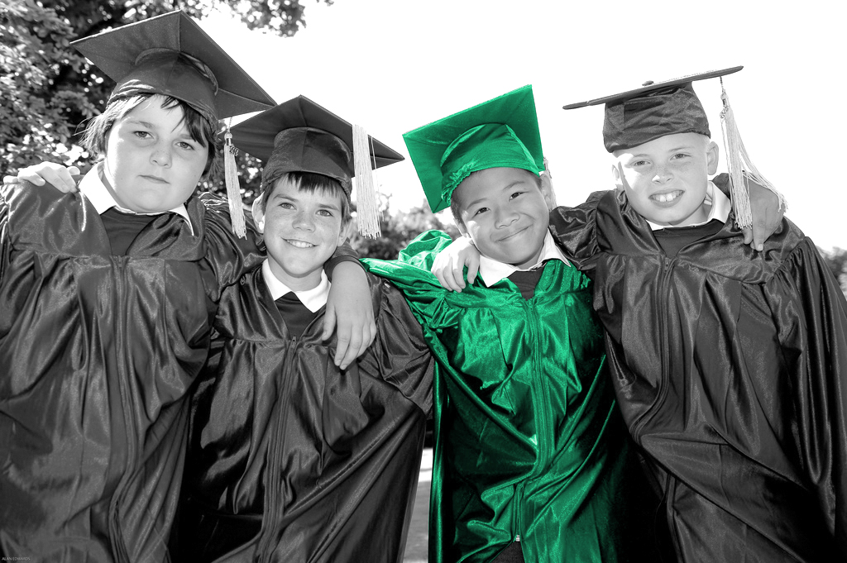
27
local Children’s Universities in
there are also
Northern Ireland, the Isle of Man, Wales, Scotland and … The Netherlands
and interest from
… Australia, Estonia, Italy, Portugal, Republic of Ireland, Malaysia, Indonesia, Singapore, Sri Lanka, India, China, Republic of South Africa, Belize and USA …

Slide 7
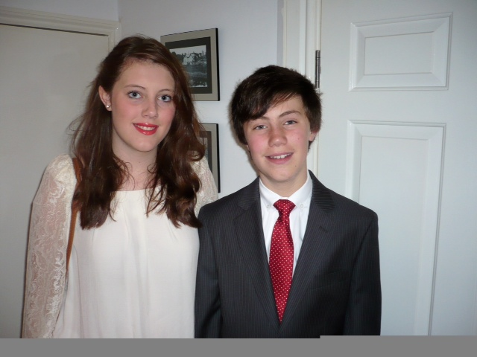
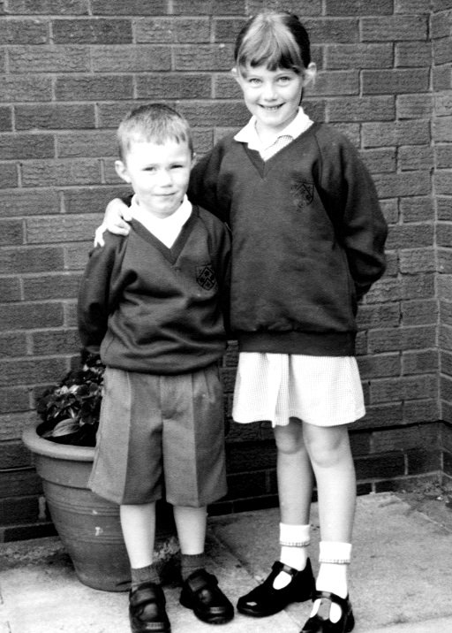
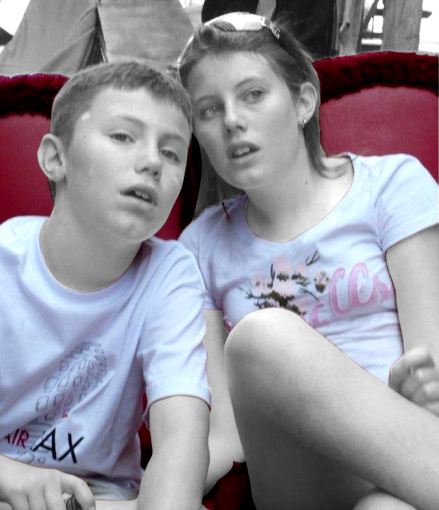

Slide 8
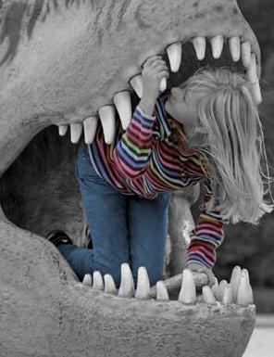
CU next …
Maintain …
our aspirations
Grow …
participation
activity
adventure
advocacy
communication
organisation
Maintain …
quality
Stay …
family and friends!

Slide 9
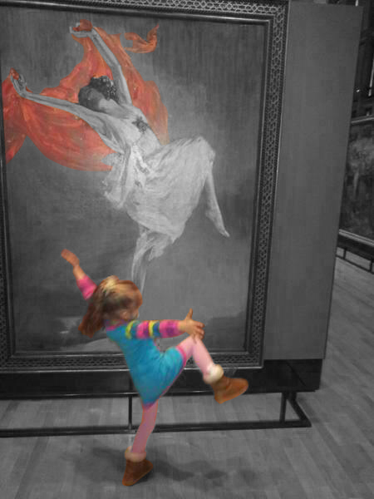
CU USP …
The Children's University (CU) is an international charity that provides 7 to 14 year olds (and 5 and 6 year olds with their families and carers) with exciting, innovative high-quality learning experiences outside the normal school day, at weekends and during the holidays throughout the British Isles and beyond. Participation is voluntary.
There are in excess of 115 local Children’s University centres across the British Isles all managed to meet the needs of their local communities and all involve local universities, colleges and schools. There are also CU developments in the Netherlands, Italy, Portugal, Australia, Singapore, Malaysia, China and India.
Although open to all, the Children’s University aims particularly to reach children facing educational and socio-economic disadvantage.
Our aim is to raise aspirations and develop a love of learning by issuing children with a ‘Passport To Learning’ which records their individual learning journey. The children are rewarded for their participation with certificates at graduation ceremonies at grown-up universities with proud parents in the audience.

Slide 10
CU USP …
The activities are practical, fun based and voluntary and include after-school clubs, community activities, and learning at museums and theatres, in parks and galleries and even at B&Q and the BBC. Children are also encouraged to attend CU lectures and seminars at universities in order to whet their appetite for future learning.
After the age of 14 Children’s University ‘alumni’ can continue their involvement through our CU Volunteering scheme which is linked to the Duke of Edinburgh Award.
The Children’s University aims to develop the understanding that learning can be a satellite navigation to better places in life … all under the motto “aspire to inspire”!
Independent evaluations by the University of Cambridge have shown that the Children’s University makes a difference to children’s learning and achievements, both in and out of school.

Slide 11
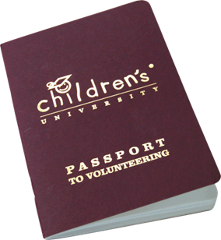
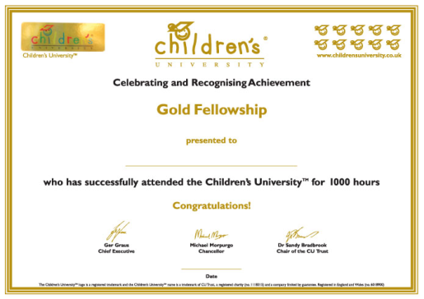
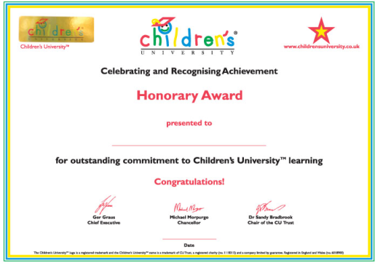
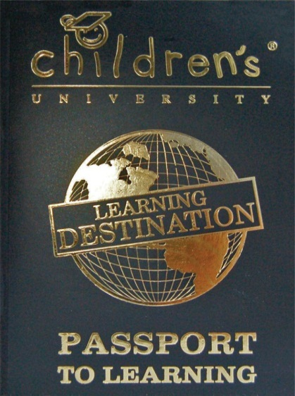
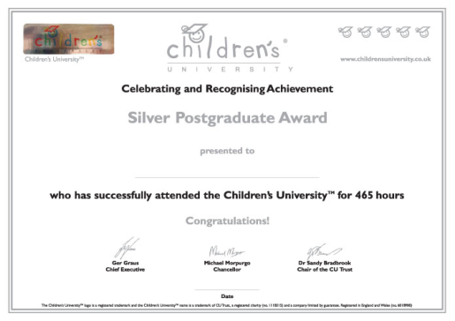
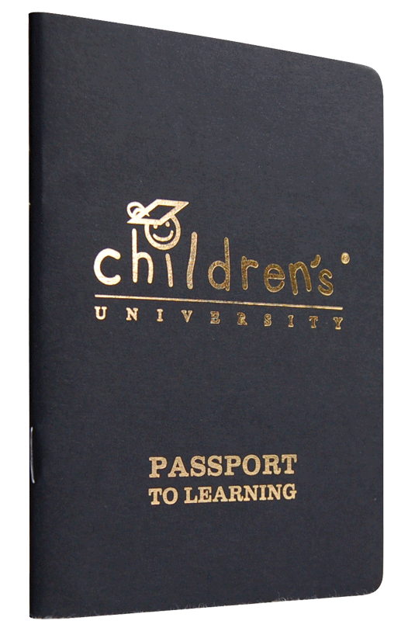
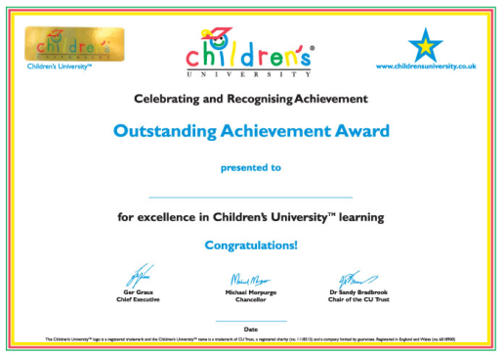
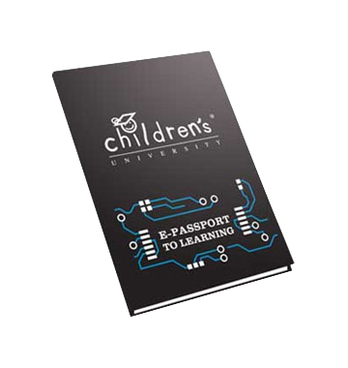
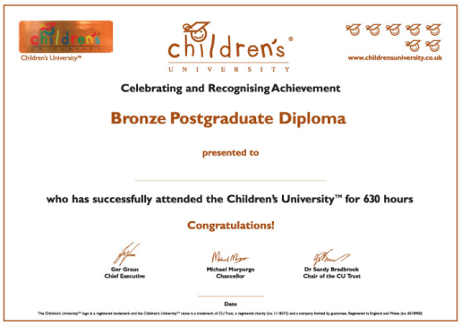

Slide 12
“The aim of teaching is not to produce learning but to produce the conditions for learning, this is the focal point, the quality of learning.”
Loris Malaguzzi
L’occhio se salta il muro: Narrativa del possibile
[When the eye jumps over the wall: Narratives of the possible]

Slide 13
CU next year …
14th June 2013 CU Managers’ Meeting – Manchester
14th October 2013 Regional CU Managers’ Meeting (North)
16th October 2013 Regional CU Managers’ Meeting (South)
18th October 2013 Regional CU Managers’ Meeting (Central)
2nd & 3rd December 2013 6th Annual CU Conference
www.childrensuniversity.co.uk

Slide 14
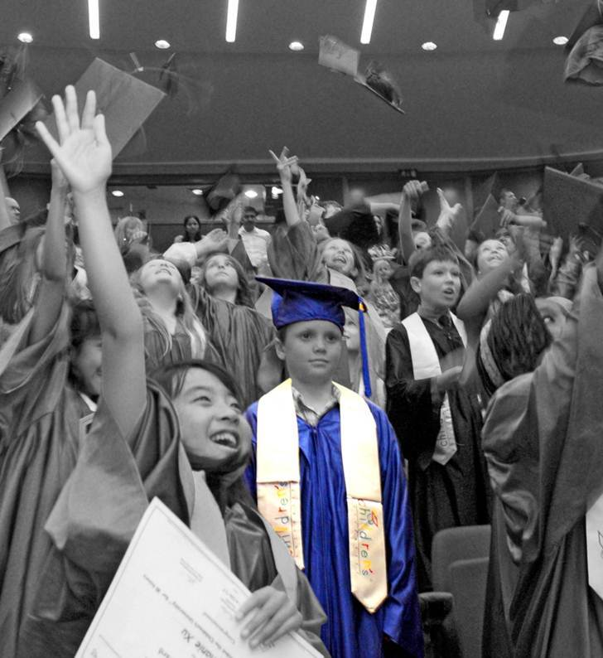
“Awe and wonder or ... is the hat stuck!?"

Slide 15
www.childrensuniversity.co.uk

