Slide 1
Values That Underpin the CU Trust
Encourage Voluntary Participation
Stimulate and Support Local Leadership
Everything at a High Quality
Learning is Child Directed
Reviews are Independent and Authoritative
All Parts of the CU Movement are Financially sustainable

Slide 2
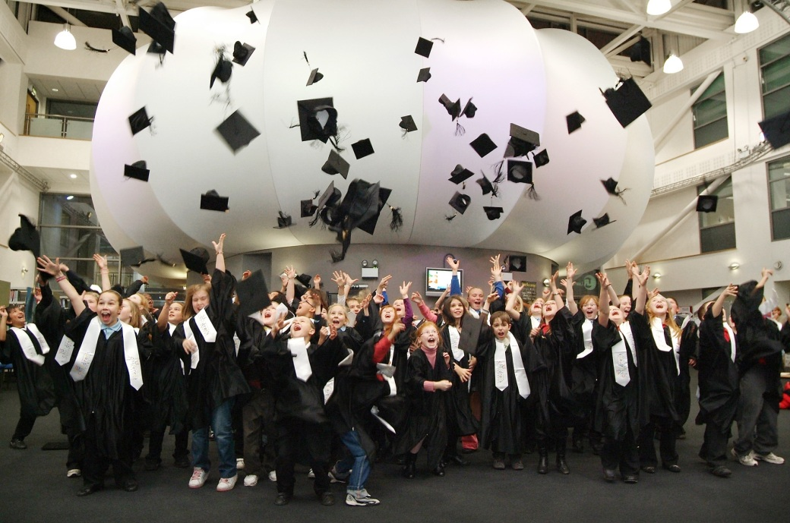
Schools and Academies
Partner organisations
HE and FE
Children
Local Authorities
New local CU legal Structures
CU Managers
National CU Office
Chancellors and Patrons
CU Trustees

Slide 3
The future
Continue our Growth
Better and More Effective Publicity and Belief in the CU
Innovative Partnerships
More Funding not just from Government

Slide 4
You are Successful
Children do Benefit
Society will Benefit

