Slide 1
A Place for Success
John MacBeath
University of Cambridge
‘”

Slide 2
Who said?
‘Teachers teach and children learn. It’s as simple as that”
‘Teachers do not produce learning……..

Slide 3
‘Teachers do not produce learning, they produce the conditions for learning’

Slide 4
Exploring space
It recast the spaces around the centre in a new light for me. I enjoyed the way that new relationships and experiences were made present by the children’s interaction with the spaces
‘playful exploration’
‘the restless invention of children’
‘the invitation to express your own ideas’
……… with the help of a Propbox

Slide 5
Knowledge creators
“… If we believe that children possess their own theories, interpretations and questions, and that they are co-protagonists in their knowledge-building processes, then the most important verb in educational practice is no longer to talk, to explain, to transmit, but to listen …”

Slide 6
The 10 As
Attendance
Attainment
Achievement
Attitudes
Agency
Adventure
Aspiration
Awards
Adaptability
Advocacy

Slide 7
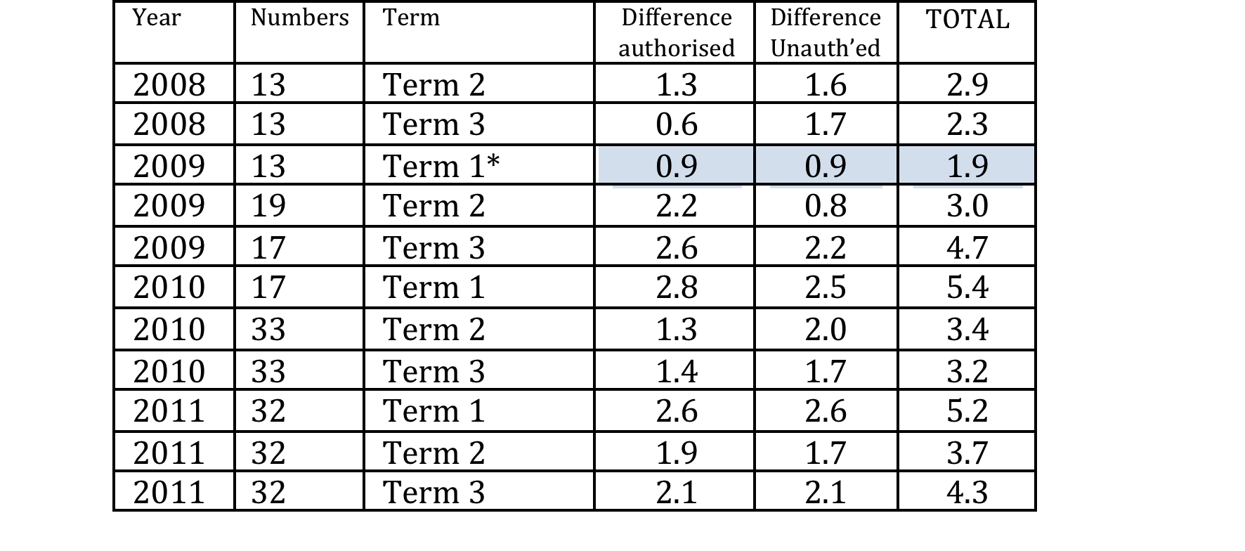
Stoke CU

Slide 8
It must be Tuesday!
“Frankie has had an amazing time, he jumps for joy when he knows its Tuesday. He has made lots of friends and can't stop talking about it.”
(Parent)

Slide 9
 | English 4+ | Maths 4+
NON CU | 67 | 67
30_+ Hours | 81 | 82
65 + hours | 82 | 81
100 + hours | 85 | 84
Sheffield LA | 77 | 78
Sheffield 2012

Slide 10
Achievement
“You do get better at learning things because all the things you do in Children’s University are about learning, and you’re not rushed or made to write everything down or get marks, so you just get better at learning anyway.” (Andrew, 9 years old)
“These activities are not only fun and keep you out of mischief but they make you like school more, help you get on better with other people and give you more confidence to do your class work and your homework.”
(Amie, 9 years old)

Slide 11
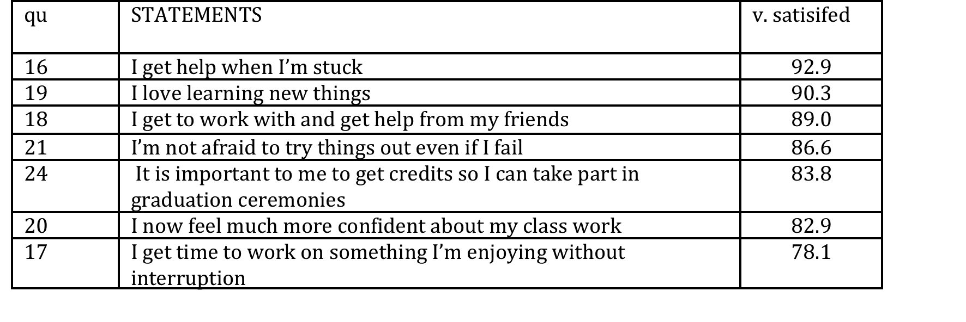

Slide 12
Adaptability
‘I’m not afraid to try things out even if I fail’.
(87% agree/strongly agree)
If at first you fail, try again.
Fail better

Slide 13
School curriculum | CU curriculum
Standardised Pre-determined Hierarchical in value Sequential Competitive High stakes Norm referenced Classroom bound Teacher led Elitist Tradition | Wide ranging Spontaneous Equality of value Multiple entry points Collaborative Low stakes Criterion referenced Beyond the classroom Student led Democratic Innovation

Slide 14
Adventure
Ad-venture, ‘venturing forth’
‘to engage in hazardous and exciting activity, esp. the exploration of unknown territory’, and as ‘an unusual and exciting, typically hazardous, experience’.

Slide 15
Agency
“I don’t have to wait for teachers to tell me what to do or to stop me doing things cos I just do things myself and find out things by myself and sometimes with other people too. I like having responsibility actually.”
(Timothy, aged 11)

Slide 17
Advocacy
There are skills such as problem solving, communication, collaboration, experimentation, critical thinking and creative expression. These skills become curricular goals in themselves and the objects of new assessment methods. Perhaps the most significant aim is for students to be able to create their own learning goals and plans—to establish what they already know, assess their strengths and weaknesses, design a learning plan, stay on-task, track their own progress, build on successes and adjust to failures. These are skills that can be used throughout a lifetime to participate in a learning society.
(UNESCO, 2012, p. 17)

Slide 18
Advocacy
There are skills such as problem solving, communication, collaboration, experimentation, critical thinking and creative expression. These skills become curricular goals in themselves and the objects of new assessment methods. Perhaps the most significant aim is for students to be able to create their own learning goals and plans—to establish what they already know, assess their strengths and weaknesses, design a learning plan, stay on-task, track their own progress, build on successes and adjust to failures. These are skills that can be used throughout a lifetime to participate in a learning society.
(UNESCO, 2012, p. 17)

Slide 19
Aspiration
“After I visited the University I thought for the first time maybe I could do that one day myself. I really didn’t know before that what a university was.”
(Suzi, 10 years old)

Slide 20
Awards
Dear Sir,
I think that there should be a platinum award rather than a 2nd gold, because platinum is more grand than gold. After platinum I think there should be Iridium, because that is only found in asteroids. When I grow up I want to work at the Large Hadron Collider.

Slide 21
Additionality
“It makes you enjoy school more and get on with your pals better because you understand them better and meet people who are different from you and like different things from you.”
(Gabrielle, 10 years old)

Slide 22
Knowing, feeling and doing
Do children know more as a consequence of participation?
What value might we place on that enhanced knowing?
Do children and young people feel differently as a consequence of their participation – About knowledge? About themselves? About school?
Are they able to do things they couldn’t do before and how are those skills valued by themselves and others, and others?
Does the CU experience widen children’s conception of learning and ignite a desire to be more adventurous and self-directed?

Slide 23
The KFD
principle
Feeling
Feeling
Doing
Knowing
Doing

Slide 24
Adding value?
To what extent does it impact on:
teachers’ understanding and approach to pedagogy or to pupil participation?
the ethos and culture of the school?
the agencies and learning destinations which children visit?
policy at national and local level, or possibly, internationally?
our understanding of learning, motivation and context?

Slide 25
Romance
Precision
Alfred North Whitehead, 1936
Generalisation

