Slide 1
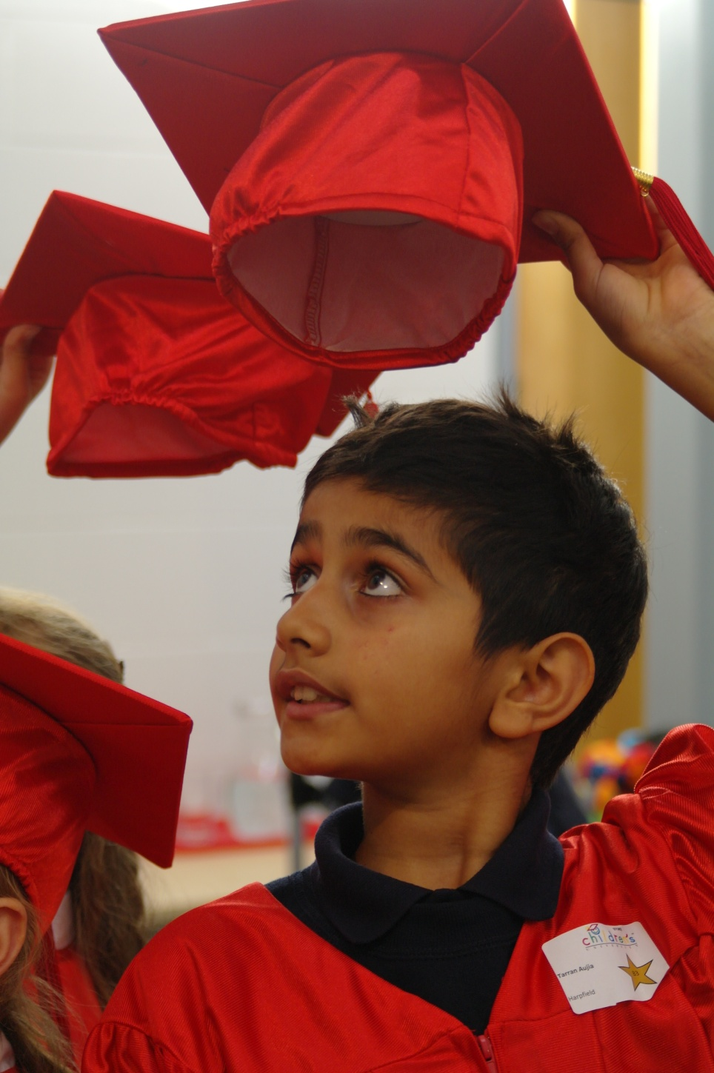
HARPFIELD PRIMARY

Slide 2
Why did we get involved with Children’s University?

Slide 3
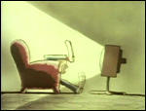
Why don't you just switch off your television set and go and do something less boring instead?

Slide 4
Fun & enjoyment
Increase engagement and participation
Offer opportunities beyond the curriculum
Enrichment of the curriculum
Work towards a specific goal
Raising aspirations
Gain confidence
Raise achievement

Slide 5
What did we do?
Asked the children which activities they would like us to offer
Audit skills of staff and plan how we could deliver.
Chair of Governors trained to validate clubs
Validated all activities
Changed the timing of the school day to allow for more learning beyond the school day.

Slide 6
Club | Year Group | Trip | Family Learning
Show School | N | Theatre, Farm, Reservoir | FAMILY LEARNING EXPERIENCES OFFERED TO ALL CHILDREN ACROSS THE SCHOOL – Family Maths, Family Literacy, Stoke Speaks Out, Family Technology, Robotics, Puppet Workshop, First Aid, Flare for Fashion, Caribbean Cook & Eat, African Crafts, Bugs & Butterflies, Let’s Be Creative, Spanish with Dora, Music Fun & Games.
Wii Club
Booster Club | R | Theatre, Blue Planet, Reservoir
Cheerleading
Origami | 1 | Blue Planet, MISP
Culture Club
Take the Stage | 2 | Theatre
French
Chess | 3 | Etruria Industrial Museum, Community Cohesion x 4 (Newstead & Stoke Minster), BT Paralympic World Cup, Olympic Torch Relay
Football
Cross Country | 4 | Theatre, Lego land, Manchester Museum of Science & Industry, Dance 12, Vue Cinema, BT Paralympic World Cup, Olympic Torch Relay.
Table Tennis
Time4Sport | 5 | Theatre, Jodrell Bank, Chester, Gladstone Pottery Museum, Etruria Industrial Museum, Thistley Hough Science Transition, BT Paralympic World Cup, Olympic Torch Relay, (Visitors include Andrew Billington Photography & Phillip Hardaker Ceramic Artist)
Film Club
Netball | 6 | Theatre, Crucial Crew, Spode, Stanley Head [High Ropes, Challenge Wall, Archery, Mountain Biking, Expedition, Bouldering, Canoeing, Raft Building, Orienteering, Nightline], Vue Cinema, Brampton, BT Paralympic World Cup, Olympic Torch Relay.
MyMaths
Creativity Club

Slide 7
IMPACT
Fantastic relationships between staff and children
Quality learning experiences beyond the classroom
Significant increased participation in activities beyond school hours.
Commitment
Love of learning
Increased confidence
Improved achievement as these values and qualities embed in all aspects of a child’s life.
A belief in themselves that they can succeed

Slide 8
School attainment: Combined L4+ in English & Maths.
23%
50%
52%
80%

Slide 9
The power of the Children’s University has given us the confidence to take the next steps for the children at Harpfield.
We are now moving towards a child negotiated curriculum.
In a nutshell: ‘The Children Decide’

Slide 10
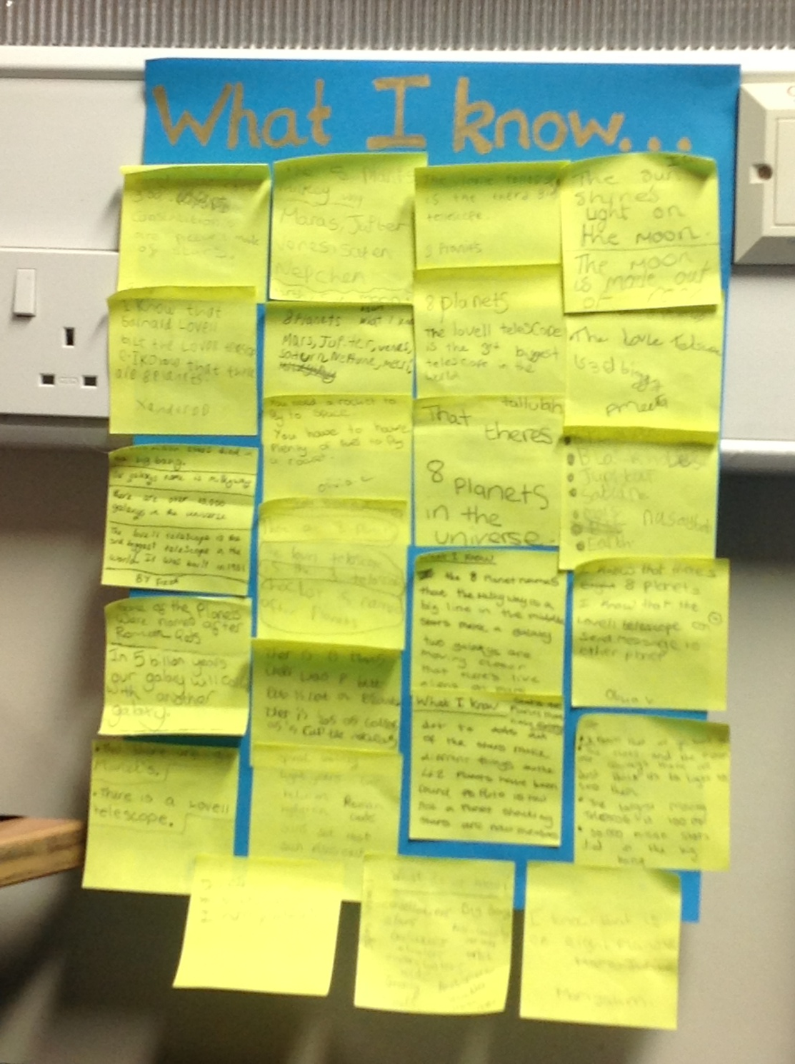
What I know already.......

Slide 11
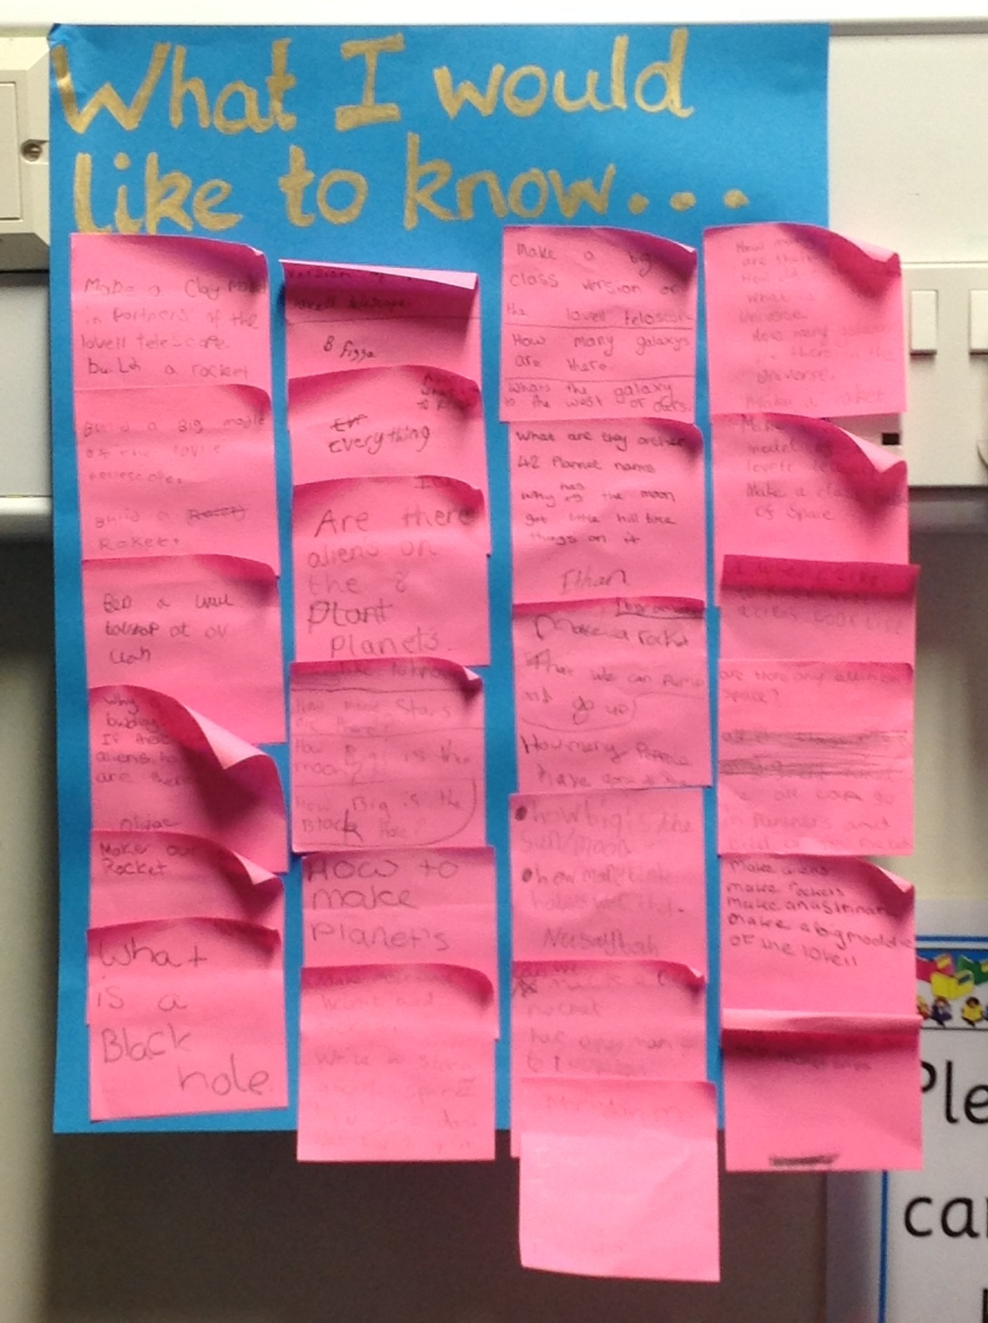
What I would like to know....
How can I find out?

Slide 12
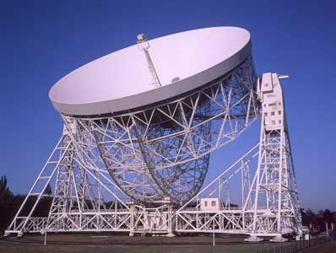
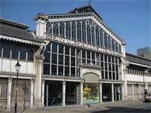
Where can we visit to find out more?

Slide 13
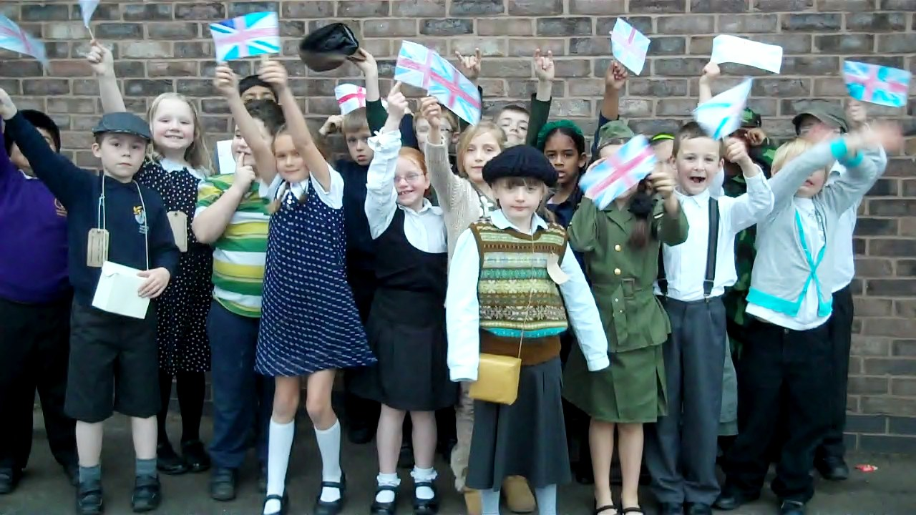
Themed activity days working with other schools in the community validated.

Slide 14
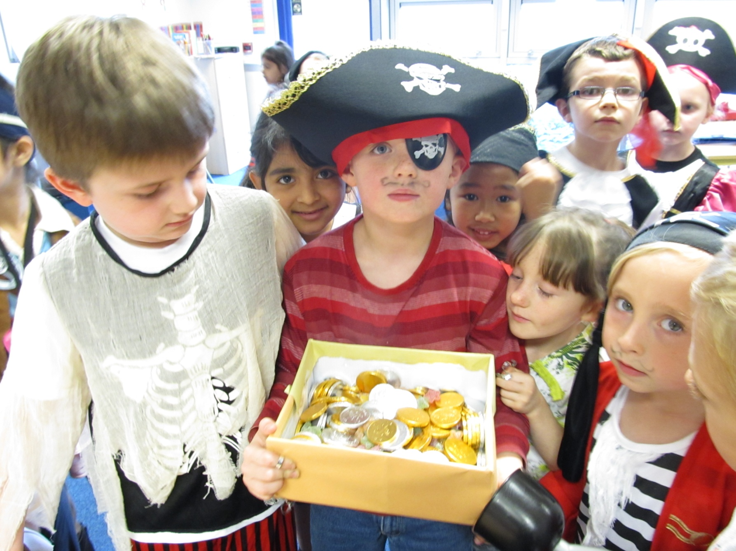

Slide 15
Learning and having fun at school and after school.
Children, staff and parents learning together.
And then of course it’s ...........

Slide 16
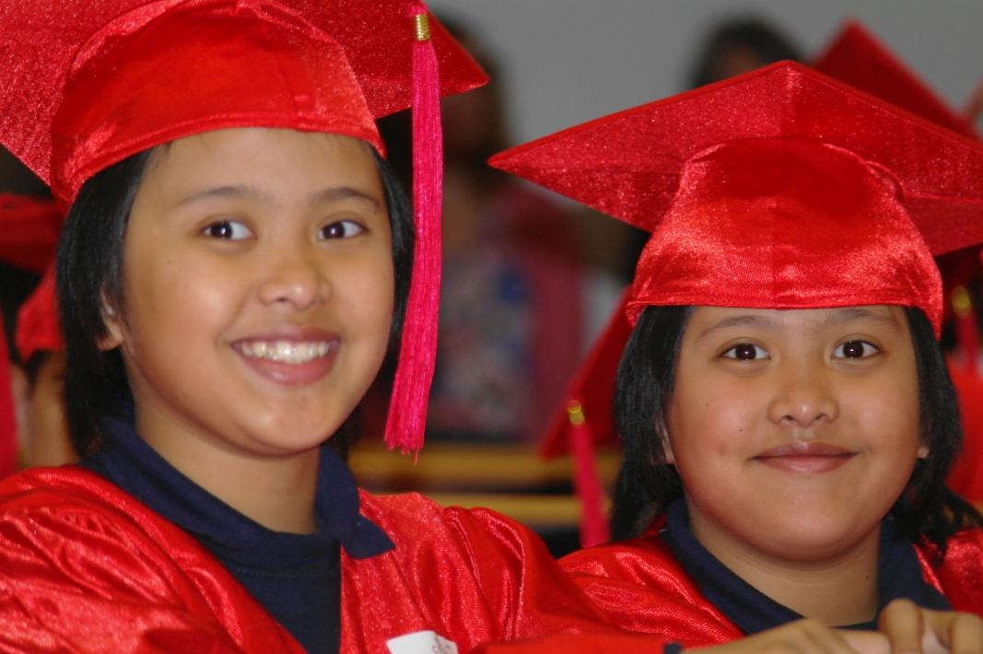
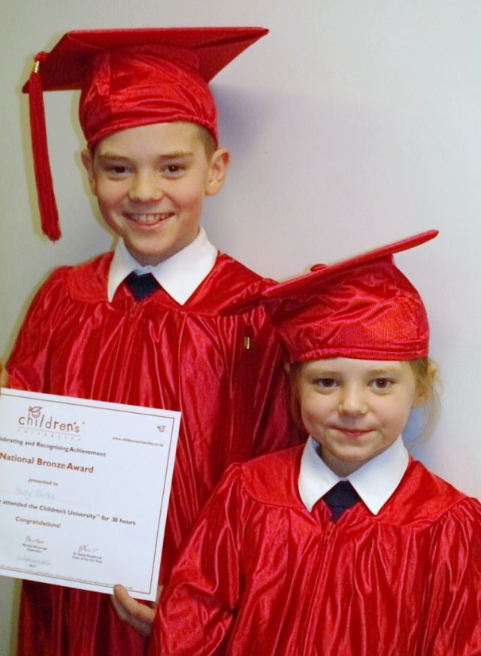
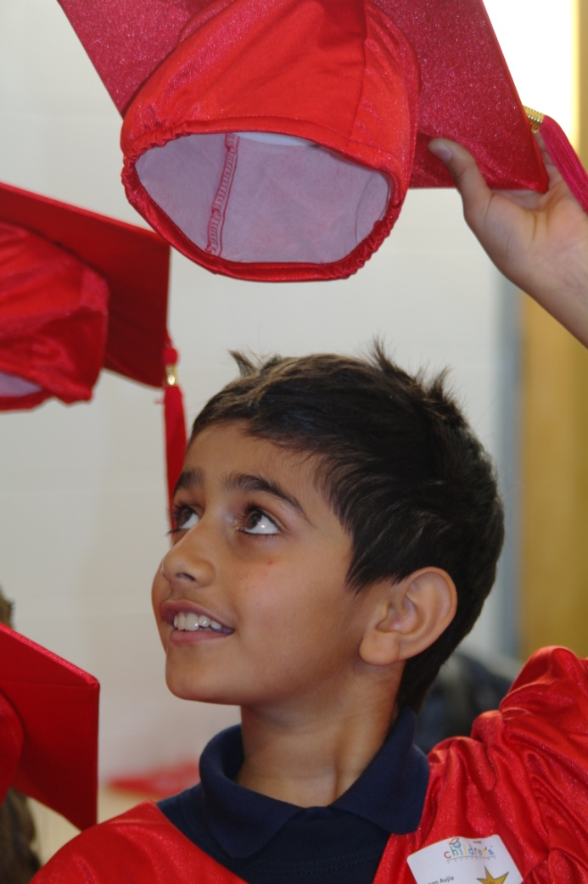
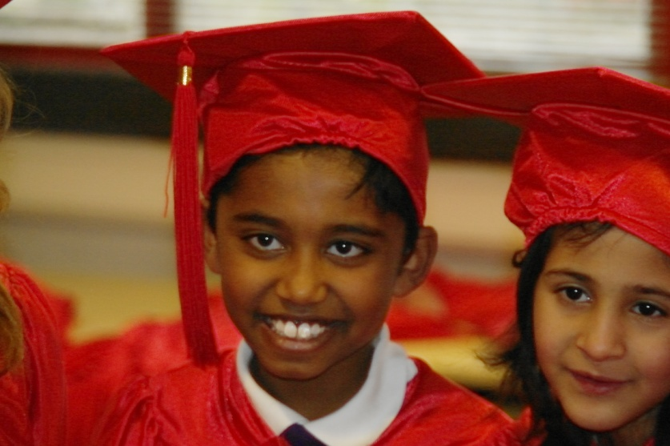

Slide 17
Children’s University is a significant organisation and continues to grow meaning that many many more young people have even more opportunities to engage.
We hope that many of our graduates go on to become the next generation of Volunteers for Children’s University

Slide 18
Without the volunteers and organisers who are involved with Children’s University our children would not be getting all of these amazing opportunities.

Slide 19
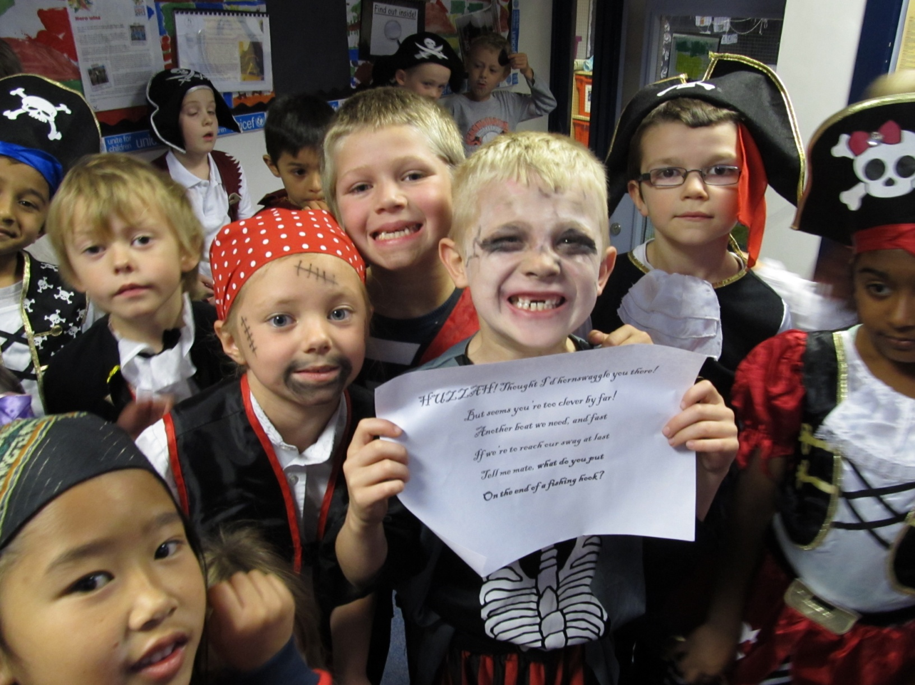
We would like to say a great BIG HEARTY THANKYOU to you all

Slide 20
Making a difference and being part of the legacy.

