Slide 1
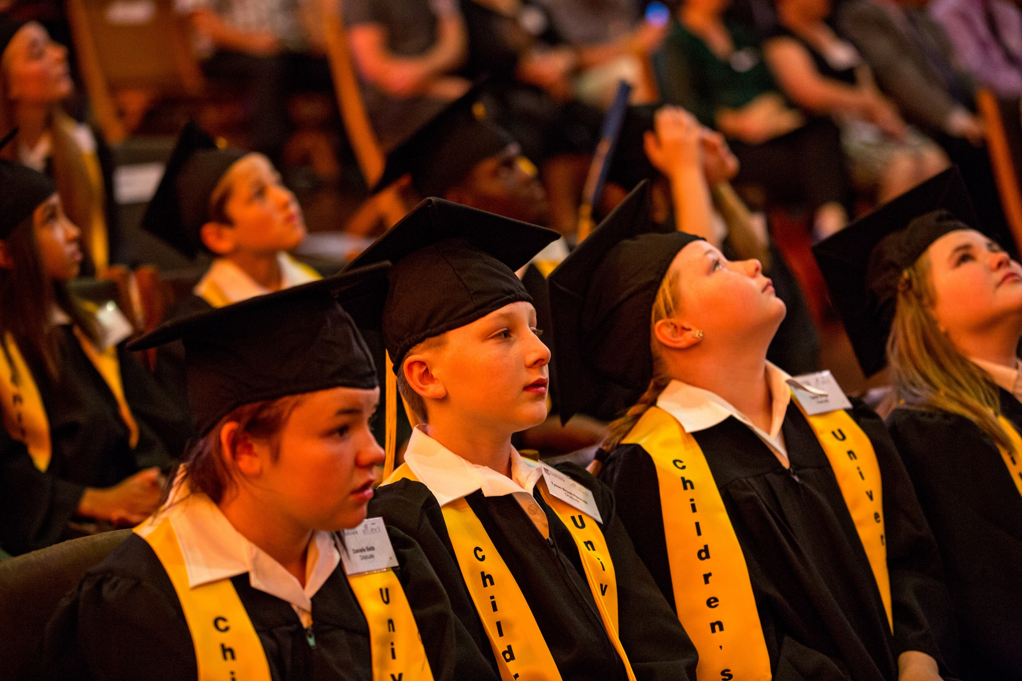
Thank you …!

Slide 2
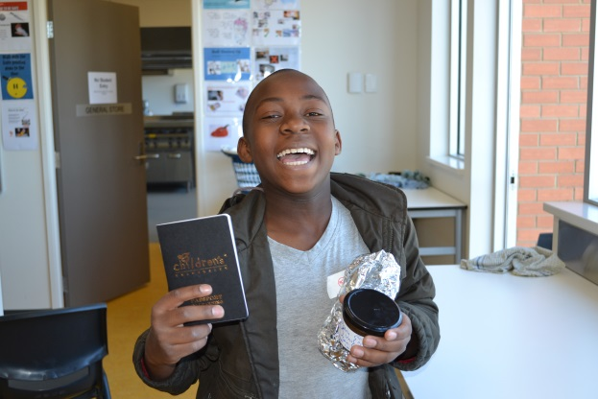
Children’s University …
2014 to 2017 (and beyond)
• growth
• quality
• sustainability
• innovation
• change

Slide 3
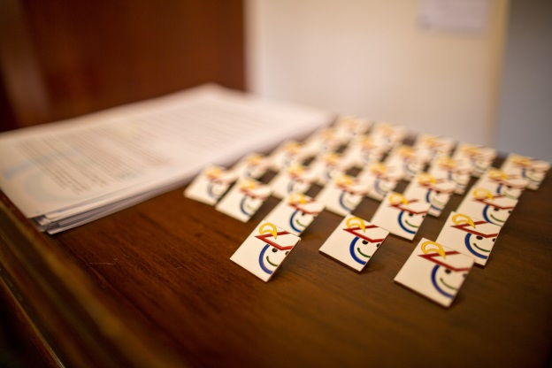
Growth
• children, hours and schools (internal)
• local Children’s Universities and campuses
• (inter)national Children’s Universities
• the learning agenda

Slide 4
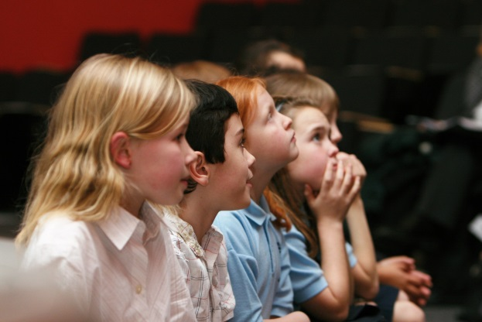
Quality
• for the children
• for the membership (local and (inter)national)
• for the learning agenda

Slide 5
• collective and individual accountability through
Planning … for Learning
for Volunteering
for Excellence (QiSS)
for (Self)Evaluation
as well as branding and other membership guidelines

Slide 6
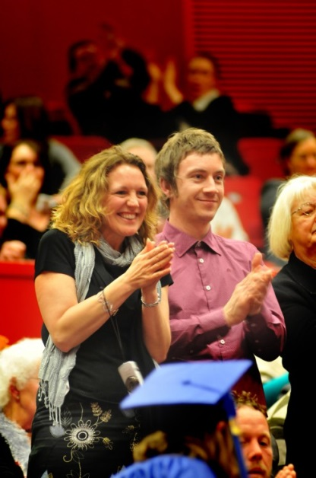
Sustainability
• what do we mean by sustainability?
• resources (financial and pro-bono)
• win-winships and realising the potential
(what can we do for others?)
• quality and the numbers game: (self)evaluation
• the learning agenda: a voice in the dark

Slide 7
• the door to sustainability is unlocked by a key
called profile
we are ‘brand’ CU …
our credibility
our values and principles
our friends
we are serious(ly) good news …!

Slide 8
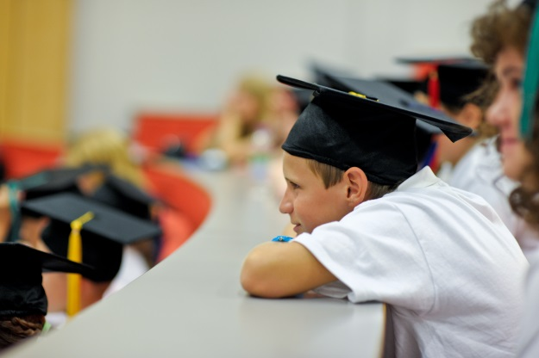
every Children’s University has a Chancellor and aims to have Patrons and Friends and uses them for events, contacts, blogs, graduations, newsletters, fundraising events …
every Children’s University aims to be in the local or regional press (or (inter)national) at least twice per year – try local radio too (and the telly)
every Children’s University aims to have something on Youtube at least once per year (and ‘feeds’ our Youtube channel) – and use it!

Slide 9
every Children’s University is on Twitter (and Facebook)
every Children’s University tries to develop a marketing relationship with a local or regional institution (or (inter)national), e.g. a university or a business partner or other to work on joint-interest news
every Children’s University shares their news with everyone else including schools, families, friends and the children of course … and makes us smile!

Slide 10
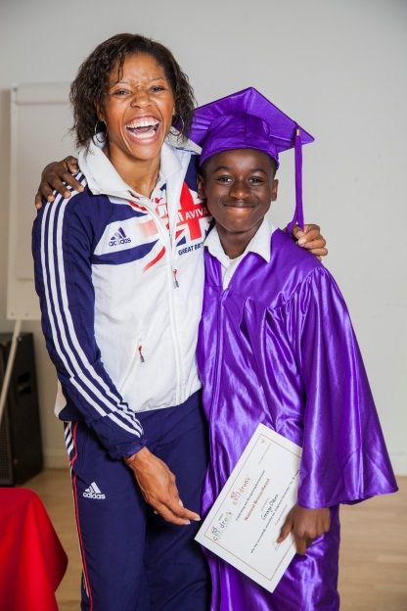
Innovation
• the ‘how’ and ‘who’ agendas
the management and leadership agenda
• the learning agenda
rewarding innovation?
• the charity agenda
hearts AND minds

Slide 11
Change
Pronunciation: /tʃeɪn(d)ʒ/
verb
• make or become different
noun
• an act or process through which something becomes
different

Slide 12
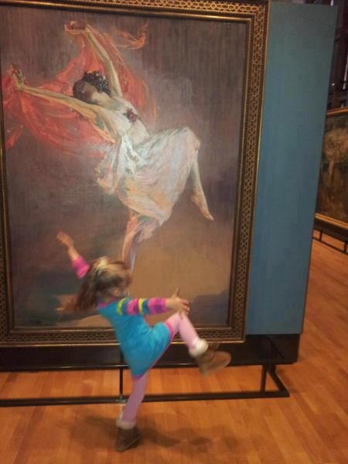
“The illiterate of the 21st century will not be those who cannot read and write, but those who cannot learn, unlearn and relearn.”
Alvin Toffler

Slide 13
www.childrensuniversity.co.uk

