Slide 1
Commitments to Each CU Participant
Each young person to reach towards their full potential
To make Learning Fun and Encourage Self-Directed Discovery
To Equip Young People for Life Long Learning

Slide 2
Values That Underpin the CU Trust
Encourage Voluntary Participation
Stimulate and Support Local Leadership
Everything at a High Quality
Learning is Child Directed
Reviews are Independent and Authoritative
All Parts of the CU Movement are Financially sustainable

Slide 3
Themes for 2013 Year
Continue our Growth
Better and More Effective Publicity and Belief in the CU
Innovative Partnerships
More Funding not just from Government

Slide 4
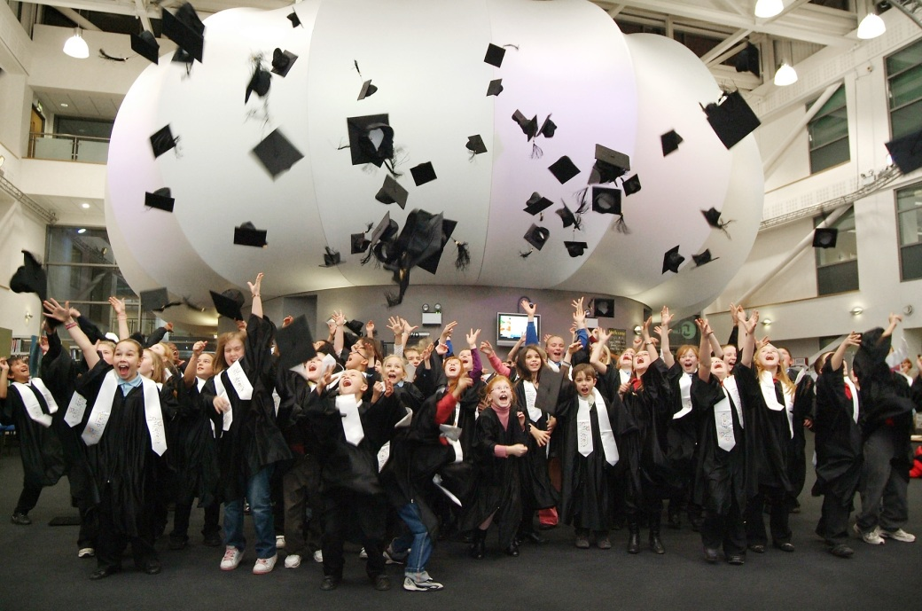
Schools and Academies
Partner organisations
HE and FE
Children
Local Authorities
New local CU legal Structures
CU Managers
National CU Office
Chancellors and Patrons
CU Trustees

Slide 5
Themes for the 2014 Year
Raising our Profile
Getting the Numbers Right
Sustainability of Each Local CU

Slide 6
Believe in Yourselves and in What you do Because
You are Successful
Children do Benefit
Society will Benefit

