Slide 1
Confident Children, Confident Communities
high hopes
Children’s University Conference – 3 December 2013
Dr Keith Bartley

Slide 2
“Never doubt that a small group of thoughtful, committed citizens can change the world. Indeed, it's the only thing that ever has.”
Margaret Mead

Slide 3
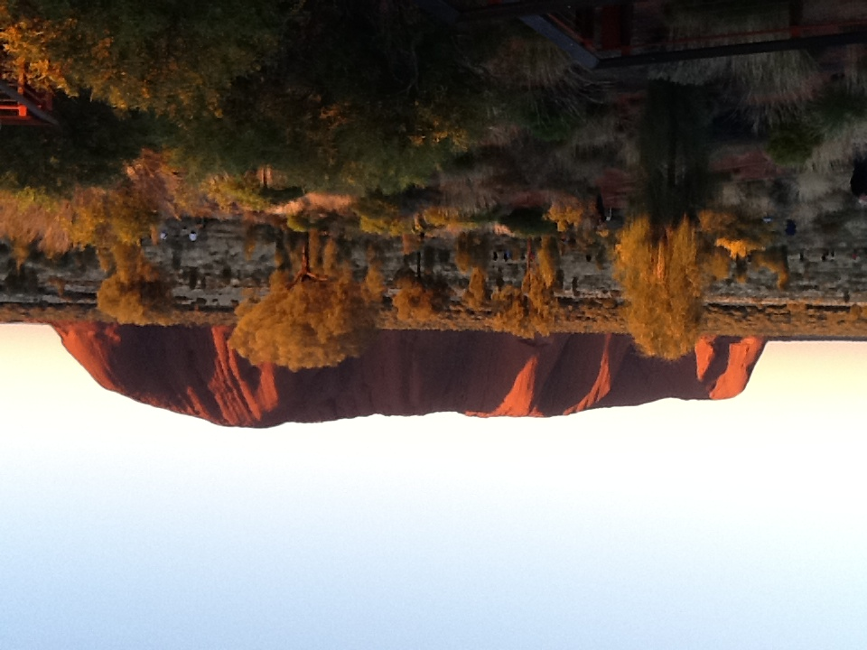

Slide 4
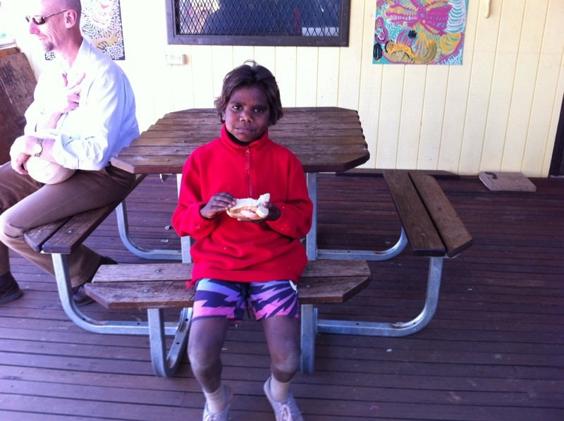

Slide 5
Positive emotion
Engagement
Positive Relationships
Meaning
Accomplishment
‘Flourish’ Dr Martin Seligman 2011

Slide 6
Essential ingredients of confidence
A sense of ‘other’
A sense of purpose
A sense of self
A sense of community

Slide 7
Confident Communities

Slide 8
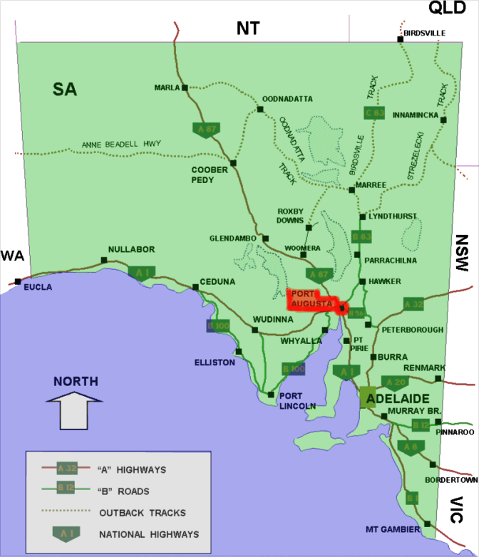

Slide 10
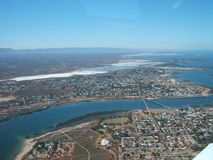

Slide 12
Children’s University as it can be……
Prove it!
Create a new box!
A dynamic / organic franchise based upon social enterprise
The leap of faith

Slide 13
