Slide 1
AGENDA
Overview of The Trust
How we link with CU
How we link with Social Action
Summary

Slide 2
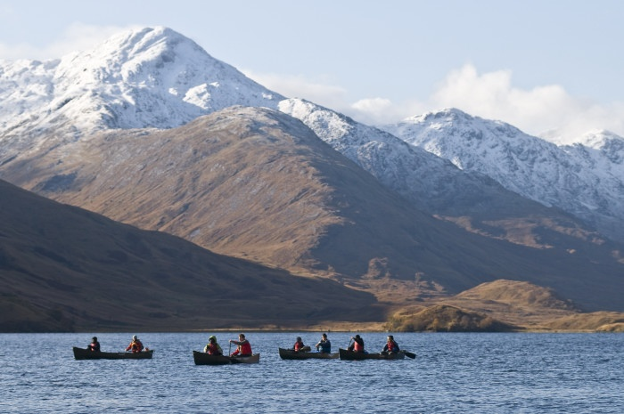
OUR MISSION: “TO UNLOCK THE POTENTIAL OF YOUNG PEOPLE THROUGH DISCOVERY AND ADVENTURE IN THE WILD”
Notes:
Educational Charity:
Start to tell them about OBT. Educational Charity – the educational but is that we are advised by a panel of senior teachers so everything we deliver in the outdoors, develops skills that will help back in the classroom.
Work with schools and colleges, individuals and corporates, including graduate and apprentices.

Slide 3
VIDEO
Outward Bound BLP

Slide 4
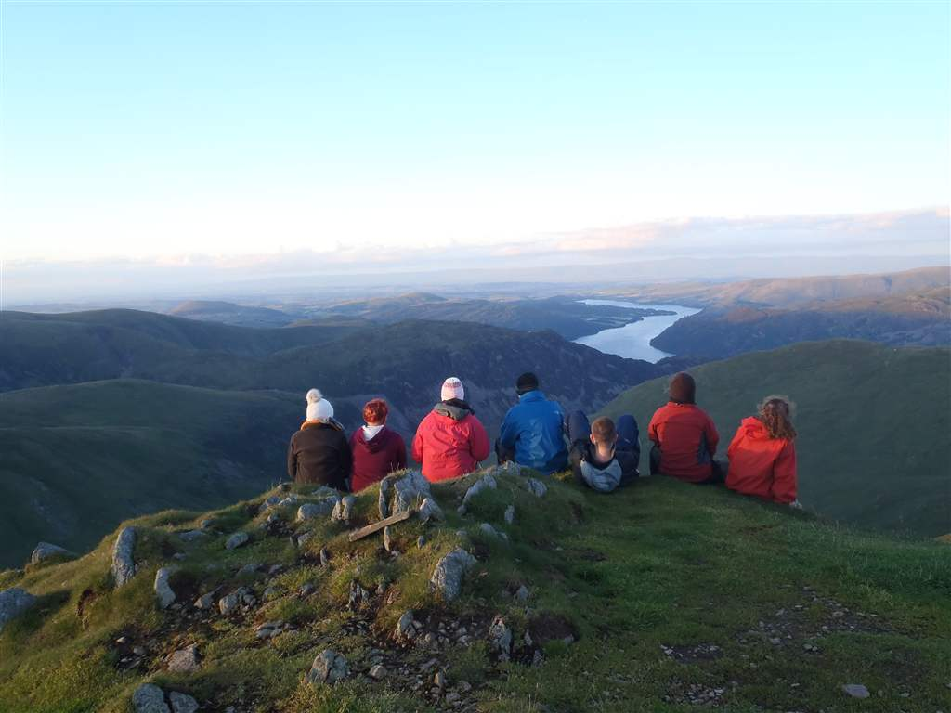
Notes:
Places. Ofsted said that “Memorable learning happens in memorable places”. Use the environment to inspire them.

Slide 5
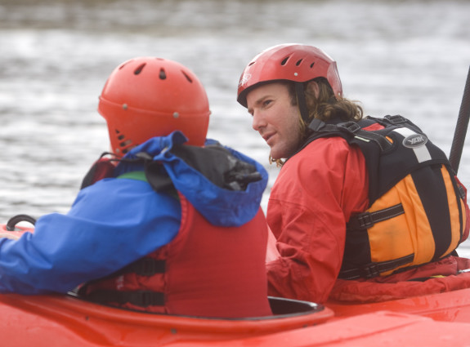
Notes:
Meet you off the bus – with you for the duration
years of experience in personal development and are both excellent outdoor instructors and educators. They have technical skills to shape the week etc and the soft skills to understand the group dynamic and support everyone etc.

Slide 6
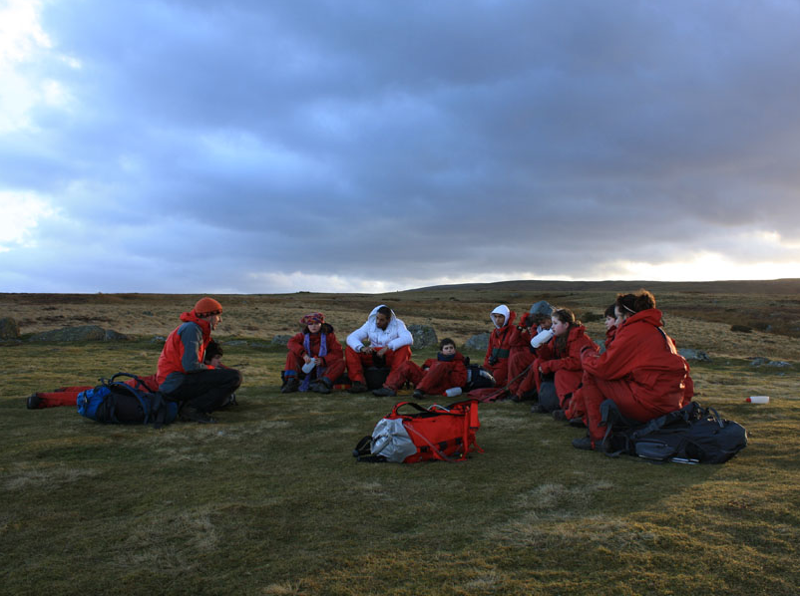
Notes:
the process of learning through experience. We’ll be asking continually “what skills are you using now, what can you do differently, how can you use that back at school”. EG, They might think that they’ve been canoeing but they’ll be using listening skills, working together etc. Some sessions will build on leadership / following. Plan-do-review-apply

Slide 7
CONNECTION TO CHILDREN’S UNIVERSITY?
CU aims | OBT evidence
Promote social mobility by providing high quality, exciting and innovative learning activities and experiences to children | See our video of Harriet for a live example
Have an ambition to raise aspirations | 83% of participants agreed “I think I will set myself higher goals in the future”
Boost achievement and foster a love of learning, so that young people can make the most of their abilities and interests | 85% of teachers observed an improvement in their pupils’ attitudes towards learning
Reach children and young people facing socio-economic and educational deprivation | 69% of students that came on Outward Bound courses last year were supported by our bursary funding
Notes:
The Y9 / 10 will be voting for the government in 3 or 4 years.... It’s not to soon to be developing good habits. They’ll need this for GCSEs, they’ll need this for their next step, whether that’s 6th form or apprenticeships....

Slide 8
CONNECTION TO SOCIAL ACTION?
Outward Bound® course content:
Working together – effective teamwork and communication
Completing an environmental project (that culminates in the achievement of the “Discovery” level of the John Muir Award)
Leadership – taking responsibility, exploring behaviour and influence
Notes:
“Social action can broadly be defined as practical action in the service of others, which is:
carried out by individuals or groups of people working together
not mandated and not for profit
done for the good of others - individuals, communities and/or society
bringing about social change and/or value
Social action can include formal or informal volunteering, the giving of time and money or simply people helping people.”

Slide 9
VIDEO
This is Harriet

Slide 10
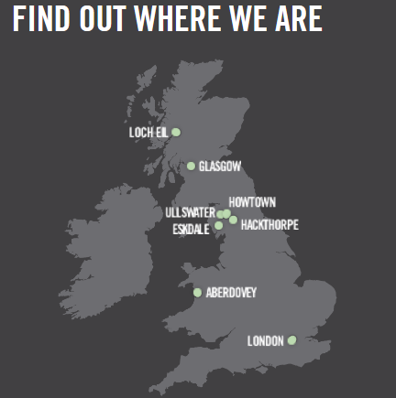
GET IN TOUCH

